Slide 1

FAKE NEWS DETECTION
Notes:
Buongiorno a tutti, io e la mia college andremo ad illustarvi il nostro Progetto, che consiste nella realizzazione di un classificatore binario per la fake news detection

Slide 2
The dataset
«ISOT Fake News Dataset»
The dataset contains two types of articles: fake and real news.
Articles were collected from real sources:
Truthful articles were obtained by crawling articles from Reuters.com (News website)
Fake articles were collected from unreliable websites that were flagged by Politifact and Wikipedia.
The dataset contains different types of articles on different topics; however, the majority of articles focus on political and World news topics

Slide 3
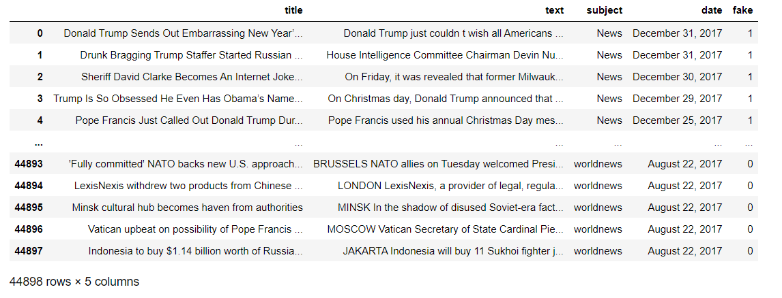
The dataset
«ISOT Fake News Dataset»

Slide 4
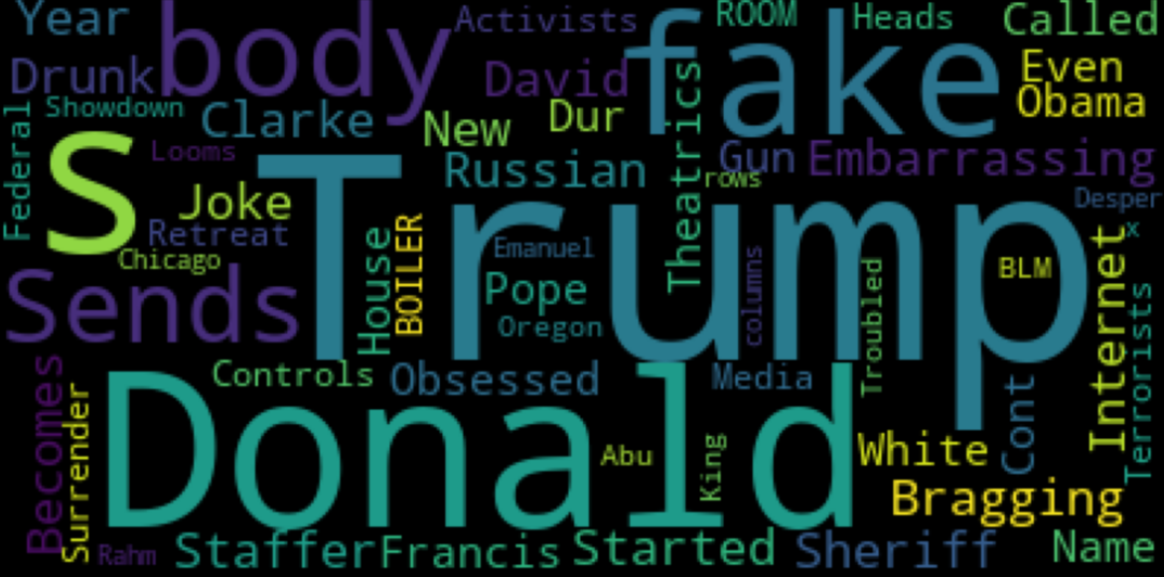

The dataset
«ISOT Fake News Dataset»
23481 fake and 21417 real news
Fake news TagCloud
Real news TagCloud

Slide 5
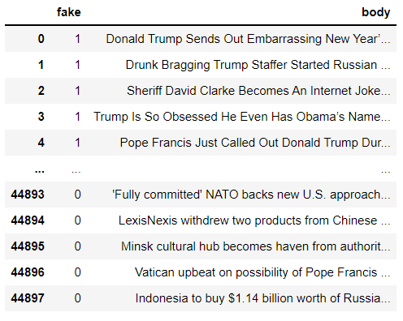
Pre-processing
Removed unuseful columns and merged «text» and «title» columns to follow the idea of TEXTUAL ANALYSIS
Duplicates removal: 21196 fake and 17908 real news, the dataset can be considered balanced
Stemming and stopwords removal

Slide 6
Features selection
About 103.000 features with only the tokenization of documents.
About 79.00 features with the stopwords removal and stemming.
In a trial, the number of features has been set to 40.000 with the stopwords and stemming approach.

Slide 7
Stemming and stopwords removal
Original Text:
«The striped bats are hanging on their feet for best»
Stopwords removal:
[‘striped’, ‘bats’, ‘hanging’, ‘feet’, ‘best’]
Snowball stemming:
Porter stemming:
[‘stripe’, ‘bat’, ‘hang’, ‘feet’, ‘best’]
[‘stripe’, ‘bat’, ‘hang’, ‘feet’, ‘best’]
Lemmatizing:
[‘striped’, ‘bat’, ‘hanging’, ‘foot’, ‘best’]

Slide 8
Workflow
The classification has been made with four different classifier:
Multinomial NB
Linear SVC
Logistic Regression
Decision Tree
two main approaches:
with and without stemming and stopwords removal
with CountVectorizer and TfidfVectorizer
and with k-cross validation for the best trials to verify the obtained results

Slide 9
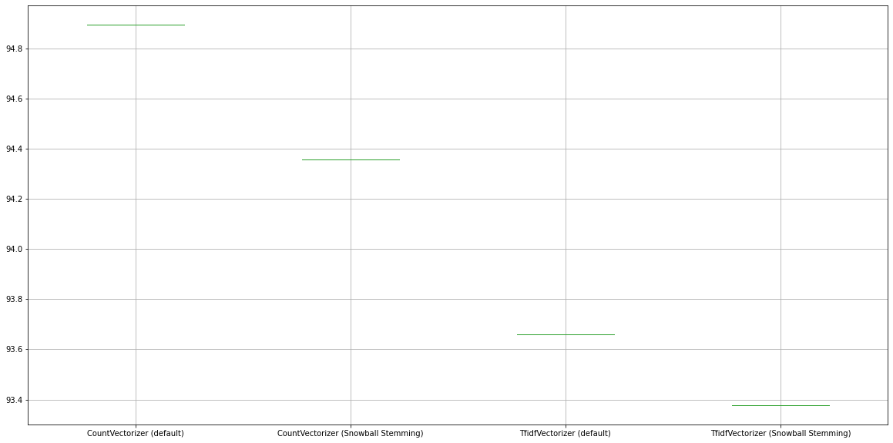
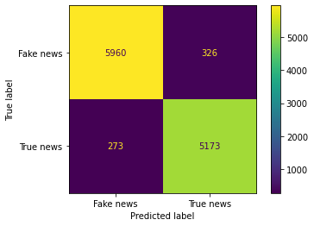
Multinomial NB
Simple Hold Out Validation
Accuracy: 94.1
Precision: 94.3
Recall: 94.3

Slide 10
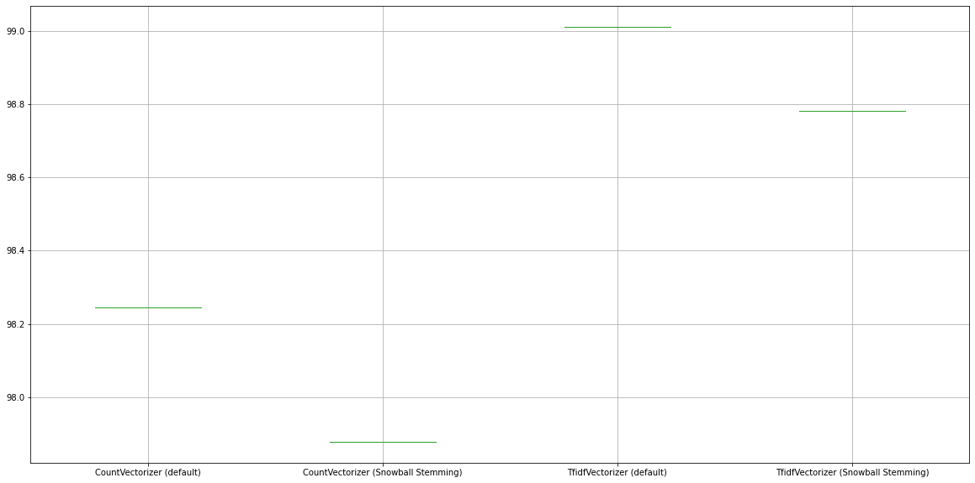
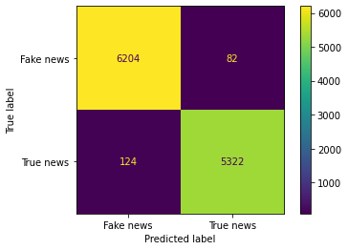
Linear SVC
Simple Hold Out Validation
Accuracy: 98.5
Precision: 98.6
Recall: 98.3

Slide 11
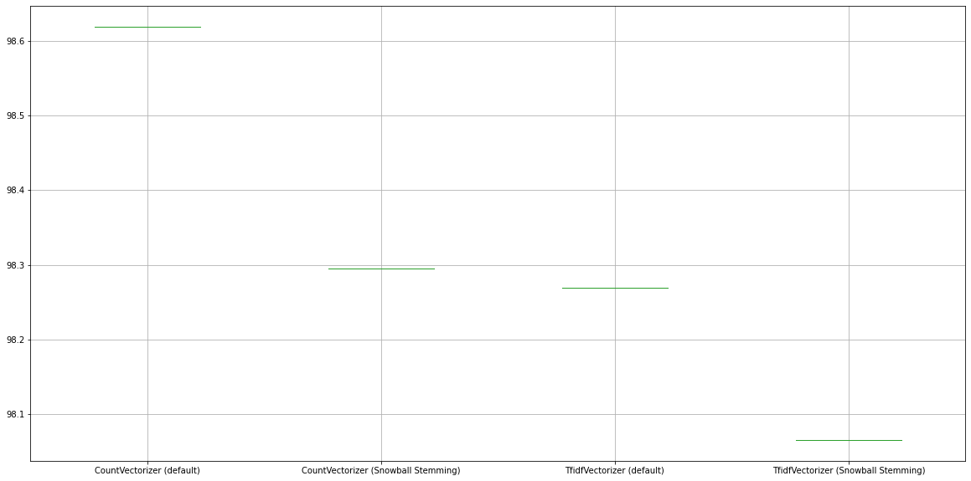

Logistic Regression
Simple Hold Out Validation
Accuracy: 98.3
Precision: 98.3
Recall: 98.3

Slide 12
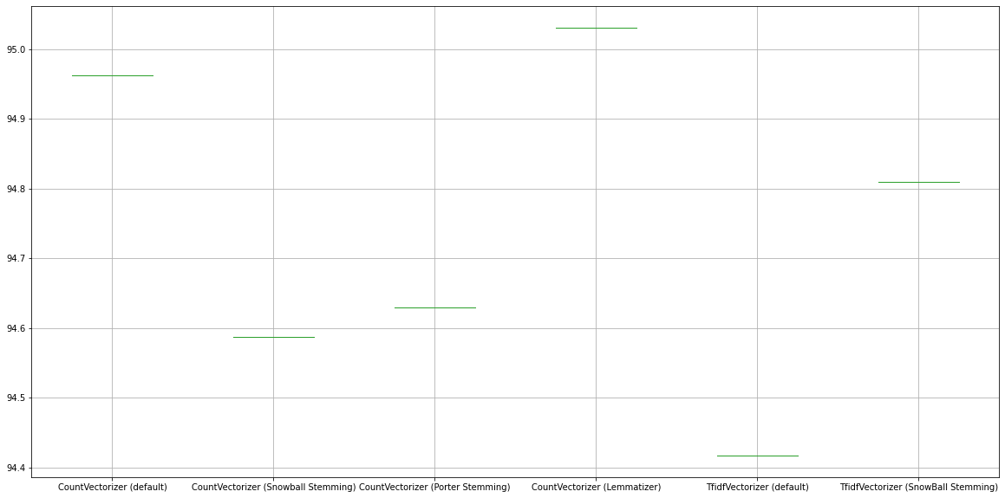
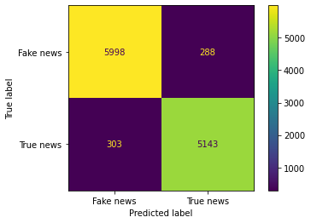
Decision Tree
Simple Hold Out Validation
Accuracy: 94.7
Precision: 94.8
Recall: 94.5

Slide 13
max_features = 40000
Simple Hold Out Validation
 | Multinomial NB | Linear SVC | Logistic Regression | Decision Tree
max_features = none | 94.9 % | 98.2 % | 98.6 % | 95 %
max_features = 40000 | 94.3 % | 97.9 % | 98.3 % | 94.9 %

Slide 14
Simple Hold Out Validation
Decision Tree
The Decision Tree plot (setting very low max_depth parameter) has been exploited to analyze which words has been used to make the splitting
Each word is represented by an integer in the vocabulary resulting from CountVectorizer which is a dict with words as keys and integers as values

Slide 15
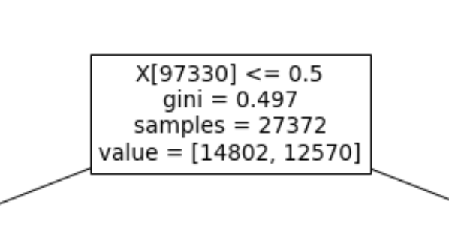
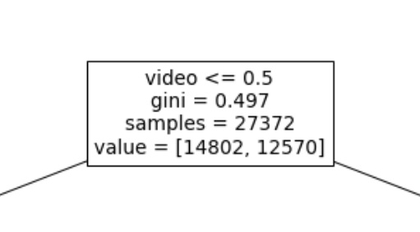
Simple Hold Out Validation
Decision Tree
Exploiting feature_names parameter, the splitting attribute that can be seen in the tree plot, is a word and not an integer.

Slide 16
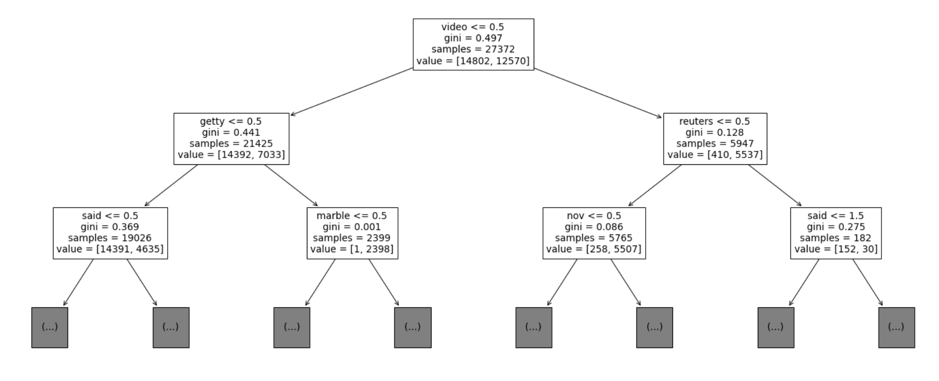
Simple Hold Out Validation
Decision Tree: CountVectorizer (default)

Slide 17
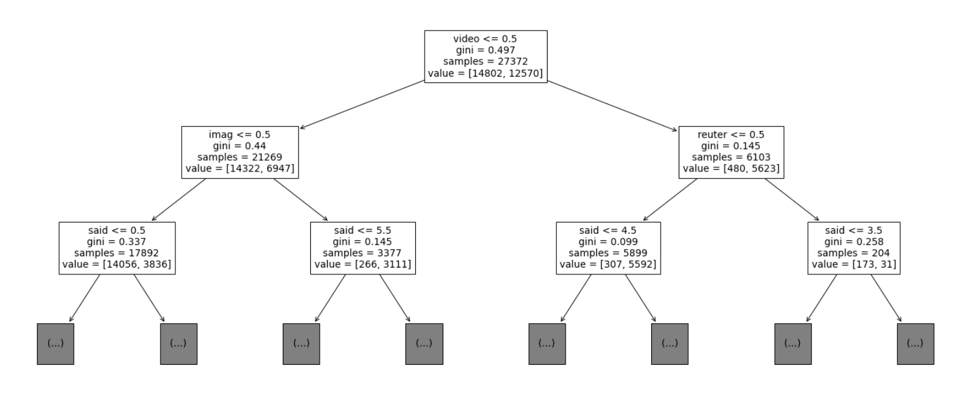
Simple Hold Out Validation
Decision Tree: CV (Snowball/Porter)

Slide 18
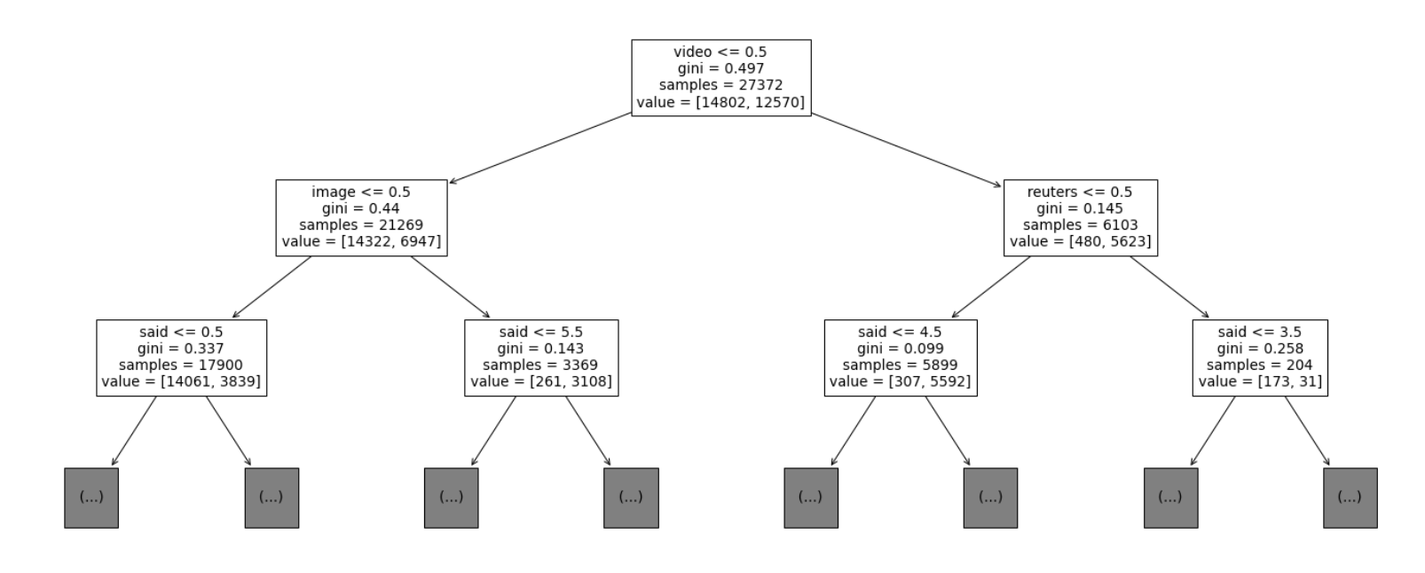
Simple Hold Out Validation
Decision Tree: CV (Lemmatizer)

Slide 19
Simple Hold Out Validation
Decision Tree: comparison
default | Snowball / Porter | Lemmatizer
video | video | video
getty | imag | image
reuters | reuter | reuters
said | said | said
marble | said | said
nov | said | said

Slide 20
Comparison
Simple Hold Out Validation
 | Multinomial NB | Linear SVC | Logistic Regression | Decision Tree
CountVectorizer (default) | 94.9 % | 98.2 % | 98.6 % | 95 %
CountVectorizer (Snowball Stemming) | 94.4 % | 97.9 % | 98.3 % | 94.6 %
TfidfVectorizer (default) | 93.7 % | 99 % | 98.3 % | 94.4 %
TfidfVectorizer (Snowball Stemming) | 93.4 % | 98.8 % | 98.1 % | 94.8 %
Mean | 94.1 % | 98.5 % | 98.3 % | 94.7 %

Slide 21
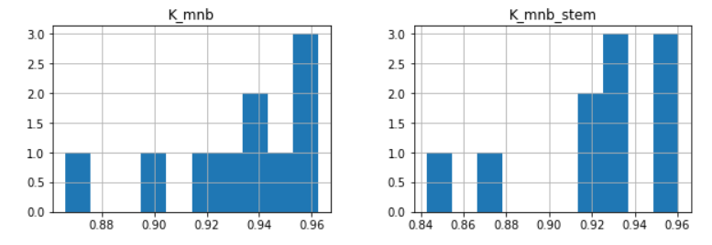
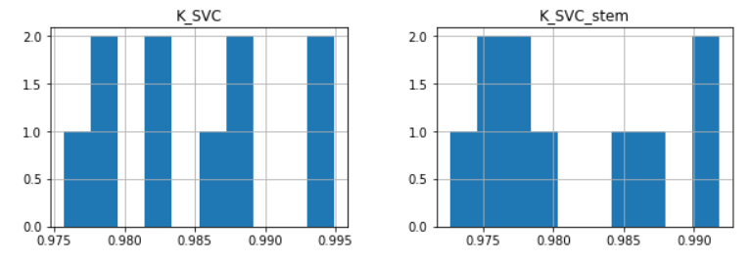
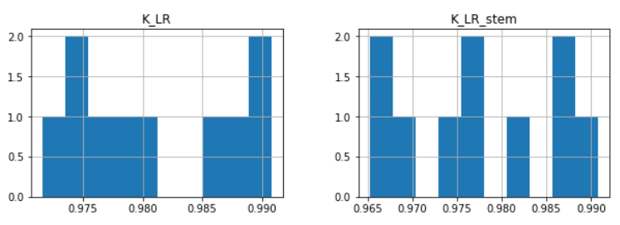
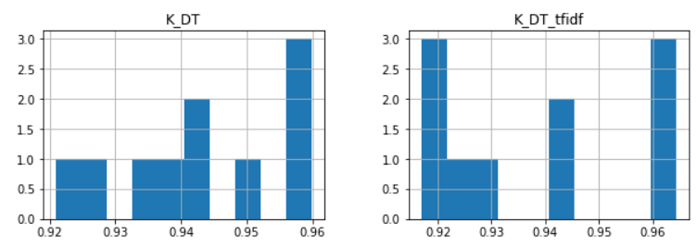
K-Cross Validation

Slide 22
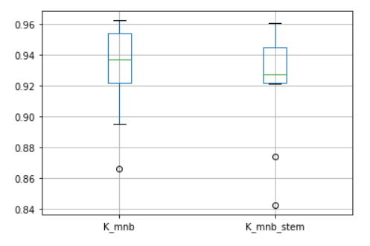
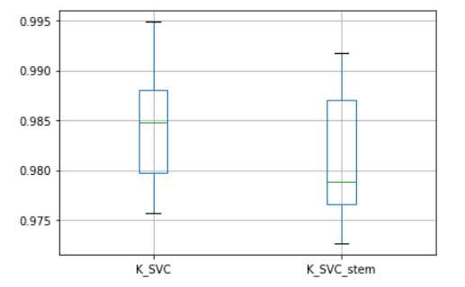
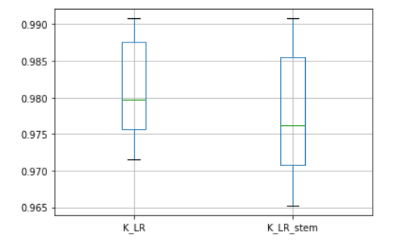
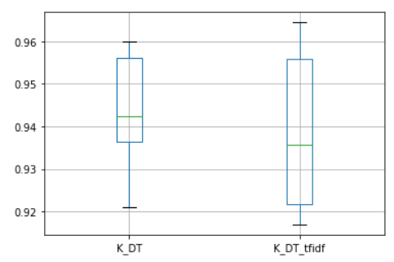
K-Cross Validation

Slide 23
Decision Tree
K-Cross Validation
Changing tree max_depth parameter there have not been really significant accuracy changes
Without specifing max_depth the tree with CountVectorizer (default) is 149 nodes deep,157 with Snowball Stemming, 150 with Lemmatizer Stemming
 | CV (default) | CV (Snowball) | CV (Lemmatizer)
default | 94.4 % | 94.1% | 93.9 %
max_depth = 15 | 94.7 % | 94.1 % | 93.9 %
max_depth = 10 | 94.4 % | 93.4 % | 93.6 %
max_depth = 5 | 91 % | 90.6 % | 90.6 %

Slide 24
Comparison
K-Cross Validation
Multinomial NB | Linear SVC | Logistic Regression | Decision Tree
CountVectorizer (default): 93.1 % | TfidfVectorizer (default): 98.5 % | CountVectorizer (default): 98 % | CountVectorizer (default): 94.3 %
CountVectorizer (Snowball): 92.2 % | TfidfVectorizer (Snowball): 98.2 % | CountVectorizer (Snowball): 97.8 % | TfidfVectorizer (Snowball): 93.8 %

Slide 25
Testing Null Hypothesis
 | p - value
Multinomial NB | 0.013671875
Linear SVC | 0.00390625
Logistic Regression | 0.009765625
Decision Tree | 0.037109375

